Slide 1
fMRI preprocessing: past and present
Natalia Zaretskaya
Notes:
I am relatively new here, so before introducing fMRI I would like to introduce myself. My name is Natalia, I am a postdoc here at the center. I did my PhD in tuebingen, Germany in Visual/cognitive neuroscience. And now I am working here at the center mostly with Jon Polimeni on high-resolution fMRI. Today we will introduce ourselves to fMRI.

Slide 2
Content
Standard preprocessing steps
SPM
FS-FAST
Notes:
I thought about it as a very very general introduction. So here is the outline of what I wanted to discuss.
I think we can’t discuss the fMRI without reminding ourselves about what we are mesuring, so I thought we very priefley go over the nature of fMRI signal and the relationship of fMRI and neural activity.
After this, we will use a classical example of a flickering checkerboard stimulus and go through all the ususal stages of preprocessing and Analysis.
I can’t pormise you that by the end of this lecture you will be able to do it right away, but at least you will have a general idea about what are the steps you need to take.

Slide 3
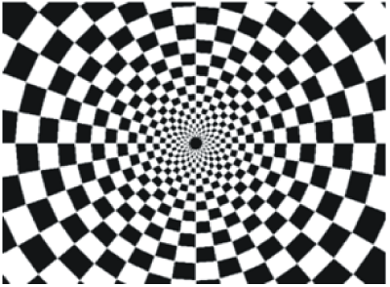
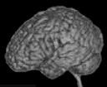
A typical experiment
20 s on
20 s off
TR
Notes:
To help us better understand the analysis steps, let’s use an example.
Let’s say we have conducted a calssical experiment in the visual system, a flickerign checkerboard.
In this experiment, we want to find out which brain areas are active when subjects view a flickering checkerboard compared to when they view a gray background.
We have shown to every volunteer a checkerboard for e.g. 20 second interleaved with a 20 s rest, and we will measure a whole brain volume every 2 seconds, for e.g. to minutes or so.
Matlab code to generate stimulus, BOLD and shifted BOLD X = [1 1 1 1 1 1 1 1 0 0 0 0 0 0 0 0 1 1 1 1 1 1 1 1 0 0 0 0 0 0 0 0 1 1 1 1 1 1 1 1 0 0 0 0 0 0 0 0];
bf = spm_get_bf; % indicated a tr of 2.5
Y = conv(X,bf.bf);
Ye = Y+randn(size(Y)).*0.2;

Slide 4
A typical research question
Which areas are activated by flickering checkerboard?

Slide 5
4D functional dataset
Repetition time (TR)
3D
time
Notes:
And, in a functional experiment we usually measure brain activity across the whole volume over extended perionds of time, so it is comfortalbe to think about each functional dataset that we acquire as a 4D dataset, which consists of 3D brain volumes and time as a 4th dimension

Slide 6
Analysis steps
Single-subject preprocessing
Single-subject analysis
(1st level analysis)
Group analysis
(2nd level analysis)
Notes:
An fMRI analysis typcally consists of preprocessing, single-subject analysis and group analysis
Preprocessing is not necessary, but should considerably increase the data quality, so usually everywone does it.
Group analysis allows to make inference about the poplutlation you have sampled from.

Slide 7



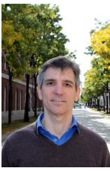
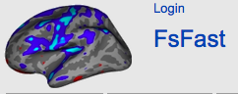


Different software, different philosophies
Since 1994
http://www.fil.ion.ucl.ac.uk/spm/
https://github.com/wanderine/BROCCOLI/
Since 1994
Doug Greve
http://afni.nimh.nih.gov/afni/
Since 2000
http://fsl.fmrib.ox.ac.uk/fsl/fslwiki/
https://surfer.nmr.mgh.harvard.edu/fswiki/FsFast
Notes:
There are many different software tools for fMRI analysis.
Here I just put a fiew of them.
Each of them has a slightly different phylosophy behind it, but all of them do roughly the same thing, so at the end it should not matter much which of them you use.
SPM – statistical parameteric mapping. It is a free matlab based toolbox. However, it depends on the matlab licence.
FSL from oxford – a set of linux tools, also free
These three are sort of older guys and the way they perform computations also got older. Nowdays there are also newer software like this one called broccolli, that can utilize GPU computing and can process the same dataset n times faster.
And last but not least, since we are here at the martinos center, I guess it is convinient to use the centeres freesurfer and fsfast routine. As you may know, freesurfer is a structural popline for cortial surface reconstruction and lot’s of other things. FsFast, developped by doug greeve, is a funcitonal module, which is very well integrated with freesurfer, and has several advantages over these two.

Slide 8
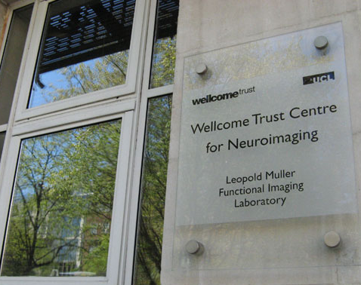
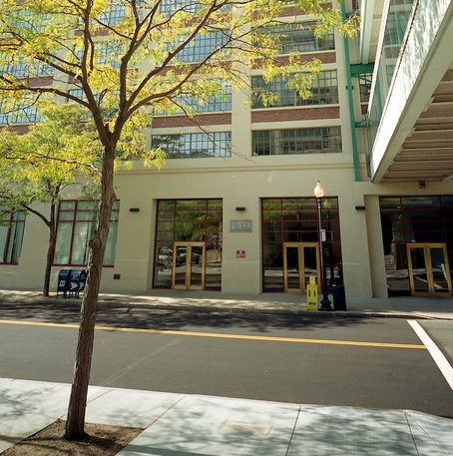
SPM vs. FS-FAST
Doug Greve
Notes:
http://buddyboy600.deviantart.com/art/London-Big-Ben-vs-Boston-Custom-House-525853803
Today we will focus on the two software packages, SPM on one hand, and fsFAST on the other.
One of the main reasons for this choice is because I am most familiar with these two ones, and can’t tell you much about the other ones.
Another reason is bacuase SPM in particular, as I mentioned, is one of the oldest software packages and one of the most popular ones, and many of the general principles of fMRI analysis were invented and first implemented in SPM. We will compare it with fsfast and see what are the advantages and disadvatages of each.

Slide 9
SPM vs. FS-FAST
GUI and usage
Philosophies
Preprocessing
First-level and group analysis
Bonus: functional connectivity

Slide 10
Typical fMRI preprocessing stream
Slice-time correction
Motion correction
Normalization to atlas space
Coregistration of functional and anatomical data
Smoothing
Susceptibility distortion estimation

Slide 11
Typical fMRI preprocessing stream
Slice-time correction
Motion correction
Normalization to atlas space
Coregistration of functional and anatomical data
Smoothing
Susceptibility distortion estimation

Slide 12
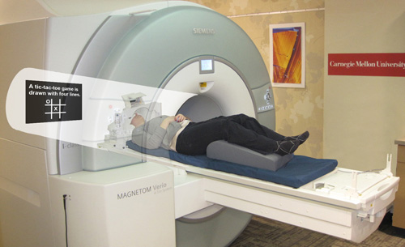
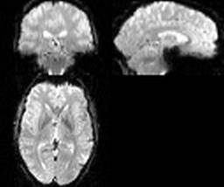
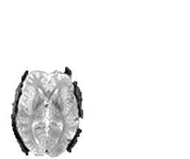
Motion correction
Purpose: compensate for subject movement
Notes:
One of the first preoprocessign steps is motion correction.
Why do we need motion correction?
During the fMRI experiment the subject is supposed to lay still inside the scanner, and they usually do so.
However, even your best volunteer won’t be perfect. And in fMRI, even a frew millimeters screw up your experiemnt.
Here is an example. Let’s say we are measuring a voxel located on the left hemishere, and the subject suddently moved.
As a result, the same voxel will be now recording activity from the empty space between the hemispheres, or even form the opposite hemisphere.

Slide 13
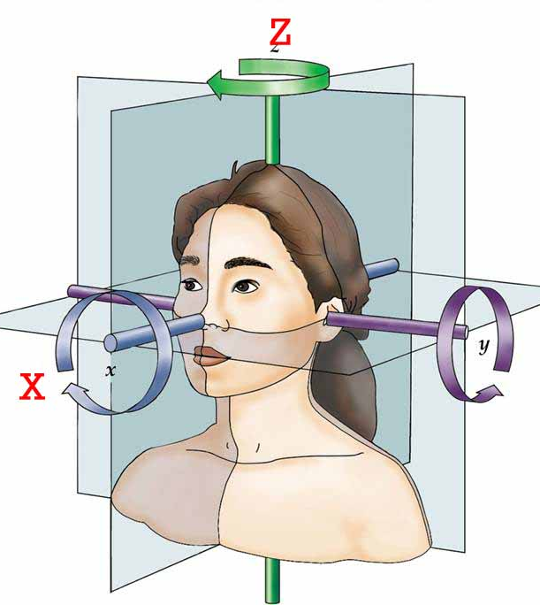
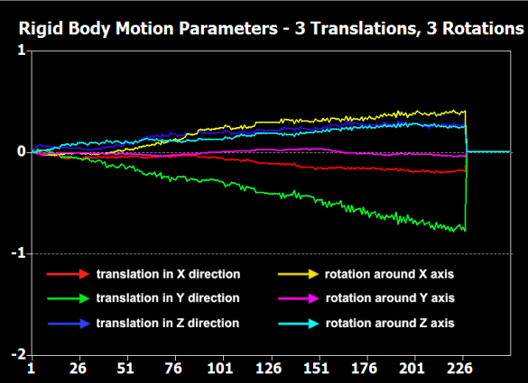
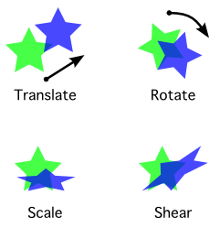
Motion correction
Purpose: compensate for subject movement
6 parameter “rigid body” transform
3x
3x
# volume
Notes:
Usually, motion is much smaller, but we still want to correct it.
How do we do this? Luckily there are special angorythms that can estimate the amoutnt of motion from one volume to the next.
This is usally done using 6 degrees of freedom: trhasnlation in x, y, and z and rotation in x, y, and z. This is called the rigid body transform, because you do not change the size and shape of the volume, but simply rotate it in space.
After the amount of motion has been calculated, it can be applied to every image to align it back to the necessary position.

Slide 14
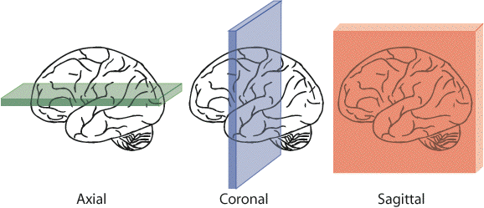
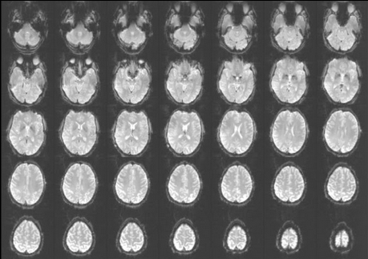
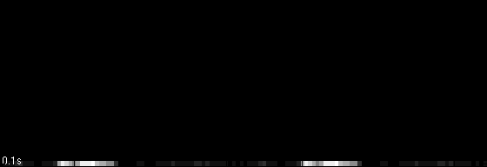
Slice-time correction
Purpose: compensate for the lag in slice acquisition
ascending
interleaved
Notes:
The next preprocessing step is slice-time correction.
What is slice time correction and why do we need it?
Remember that typically a functional volume is acquired not all at once, but slice-by-slice, as illustrated here. There are different ways in which the scanner can acquire the slices: it can bie botton-to top (ascending), decending, interleaved. There are also more complex slice acquisition patterns. Remember that the time it takes to acquire one volume is relatively long, in this our example it is 2 seconds.
Let’s say a stimulus activates two areas, here and here in the same manner.
If we acquire the slices in an asciending manner, we will measure a small signal amplitude in the frist area. By the time we arrive to the second area, the signal amplitude will increase in both areas, so we will measure a highre signal amplitude in the second area.

Slide 15
Slice-time correction
Purpose: compensate for the lag in slice acquisition
2.5 s
0 s
Notes:
Here is another way of illustrating the same issue.
The purpose of the slice-time correction realignes signals from all slices in time as if they were acquired at the same time.

Slide 16
Slice time correction: before or after motion correction?
2.5 s
2.5 s
0 s
0 s

Slide 17
SPM vs. FS-FAST
SPM
FS-FAST
Slice-time correction
Motion correction
Motion correction
Slice-time correction

Slide 18
Slice-time correction
Mostly relevant for event-related designs or timing comparisons
Can be substituted by modeling HRF derivatives if you are not interested in timing/time course analysis

Slide 19
Slice-time correction for simultaneous multislice acquisition (SMS)
sequential
SMS
2.5 s
1. 25 s
16
15
14
13
12
11
10
9
8
7
6
5
4
3
2
1
8
7
6
5
4
3
2
1
8
7
6
5
4
3
2
1
0 s
0 s

Slide 20
SPM vs. FS-FAST
SPM12
FS-FAST
You can now add slice time (instead of slice order) as input for SMS acquisition
Not in the stable 5.3 version
(perhaps in FreeSurfer 6?)
You can also use an FSL command distributed with FreeSurfer

Slide 21
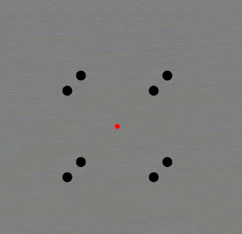
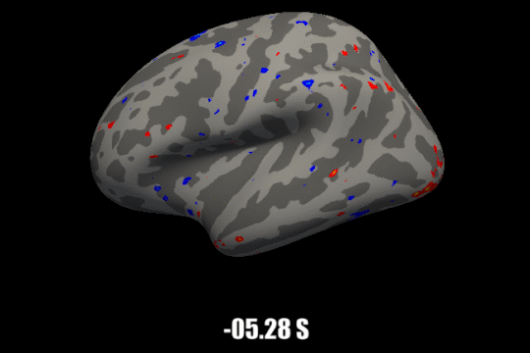
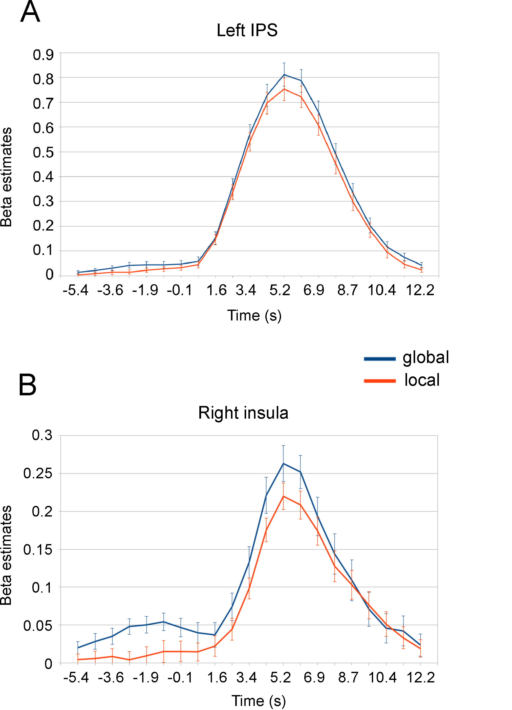
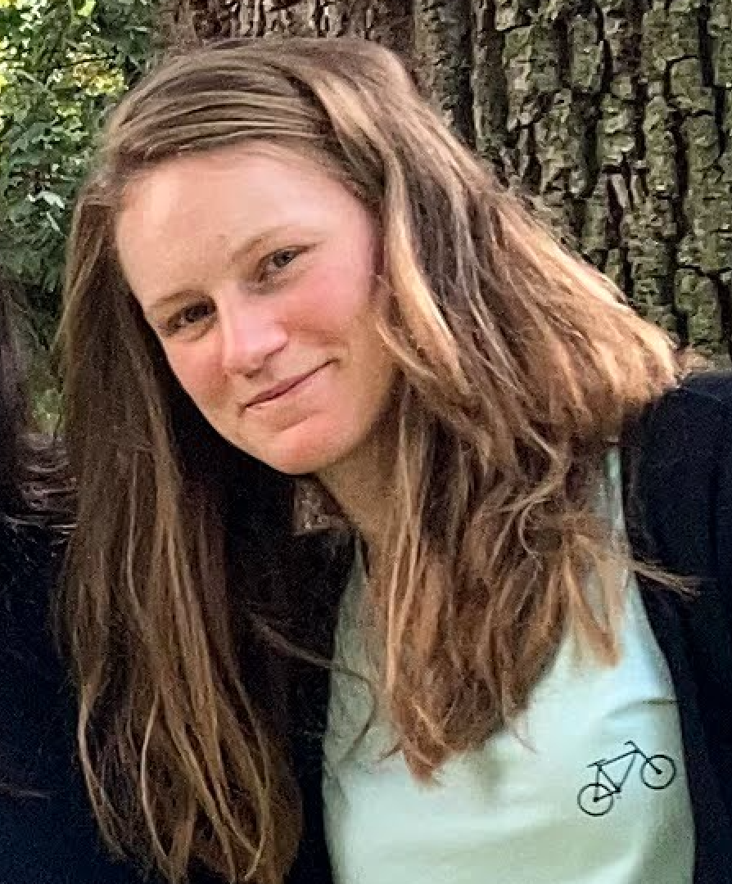
Example
Work by Marilena Wilding
https://doi.org/10.1101/2022.01.13.476145

Slide 22
Typical fMRI preprocessing stream
Slice-time correction
Motion correction
Normalization to atlas space
Coregistration of functional and anatomical data
Smoothing
Susceptibility distortion estimation

Slide 23
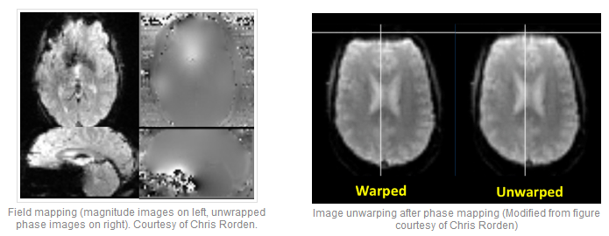
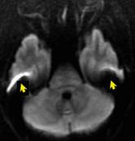
Susceptibility distortions
https://mriquestions.com/susceptibility-artifact.html

Slide 24
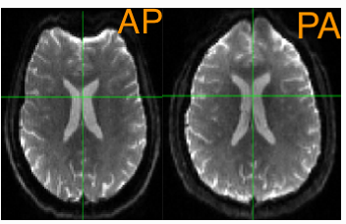
Estimate the deformation field
Fieldmap
TOPUP
https://andysbrainbook.readthedocs.io/en/latest/TBSS/TBSS_Course/TBSS_04_TopUpEddy.html
https://mriquestions.com/susceptibility-artifact.html

Slide 25
Apply the deformation field

Slide 26
Typical fMRI preprocessing stream
Slice-time correction
Motion correction
Normalization to atlas space
Coregistration of functional and anatomical data
Smoothing
Susceptibility distortion estimation

Slide 27
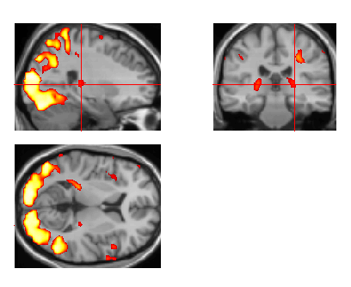
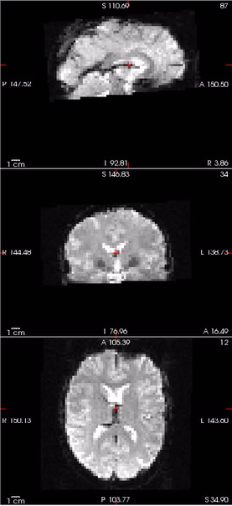
Co-registration
Purpose1: view activations on a high quality anatomical image (and more)

Slide 28
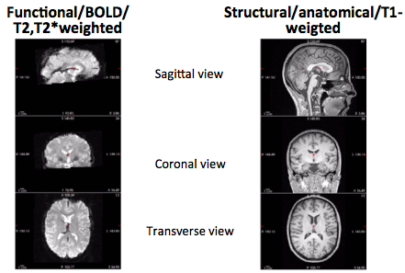
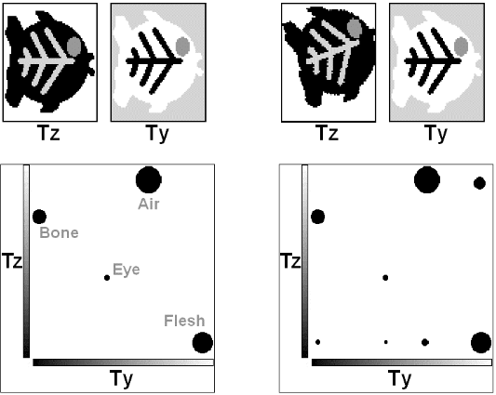
SPM: Mutual information maximization
Bianca de Haan’s fMRI guide
http://mbesc.net/wp-content/uploads/2014/07/fmri_guide.pdf
Notes:
Read
http://www.ncbi.nlm.nih.gov/pubmed/19573611

Slide 29
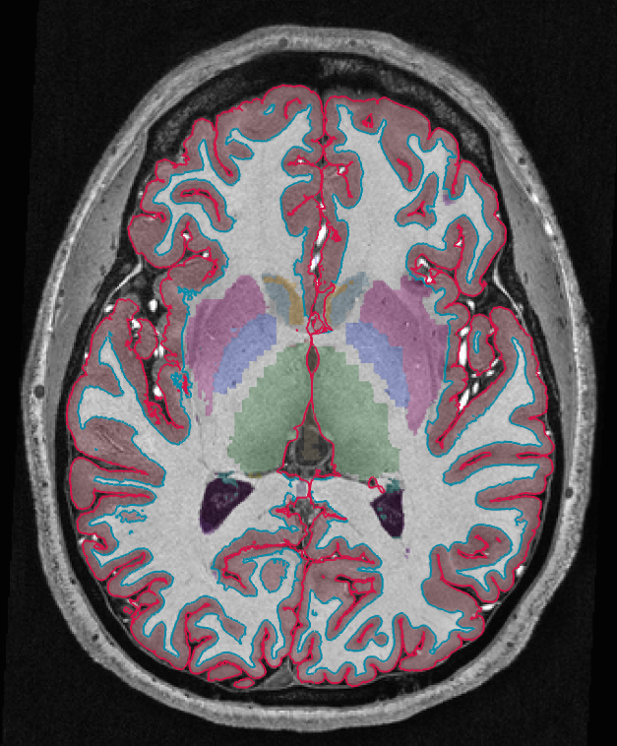
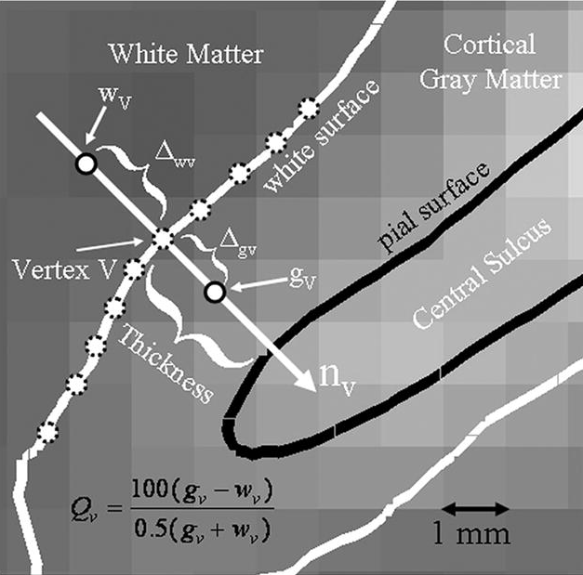
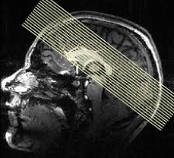
FS-FAST: boundary-based registration
Currently considered best for its purpose !
Greve and Fischl, NeuroImage, 2005
Notes:
Read
http://www.ncbi.nlm.nih.gov/pubmed/19573611

Slide 30
Typical fMRI preprocessing stream
Slice-time correction
Motion correction
Normalization to atlas space
Coregistration of functional and anatomical data
Smoothing

Slide 31
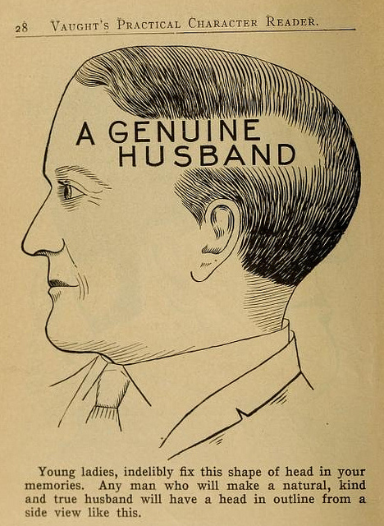
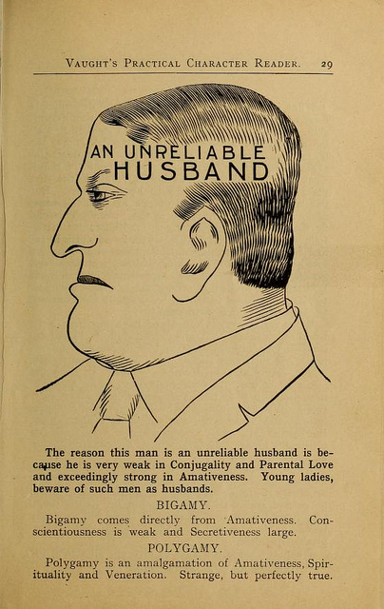
“Normalization” to common space
Purpose1: compensate individual differences in brain shape for the group analysis
http://publicdomainreview.org/collections/phrenology-diagrams-from-vaughts-practical-character-reader-1902/
Notes:
Finally, if you are preforming a group study, you also need to map each individual subject into some common space.
This is not a trivial task.
As head shpaes of people are different, there brain shapes are also different.
Here I tried to draw the approximate shape if each of these guy’s brains, and some hypotheitcal template brain.

Slide 32
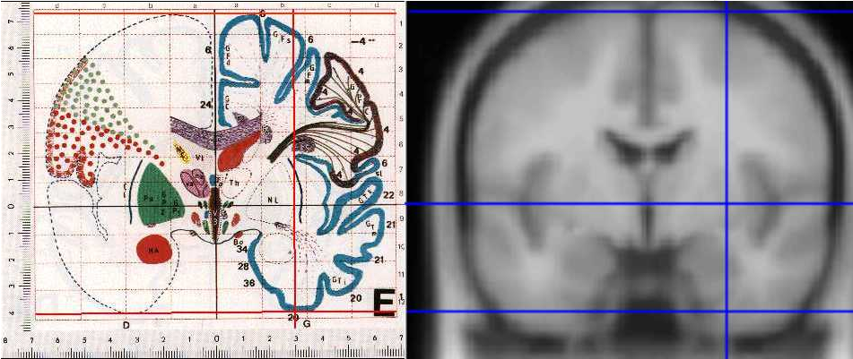
Templates & coordinate systems
Purpose2: Unified coordinate system
Talairach
MNI
http://imaging.mrc-cbu.cam.ac.uk/imaging/MniTalairach

Slide 33
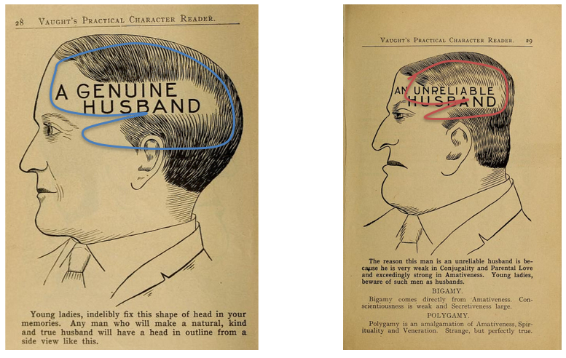
Rigid transform
Template
6 parameter rigid transform
3x
3x
Notes:
To match each of them to the template, it is not enough to coregister them as we did for motion correction, because obviously they are of different sizes

Slide 34
Affine transform
12 parameter affine transform
3x
3x
3x
3x
Notes:
We can add 6 more paraeters to the transform, which compensates does scaling and shearing, to better align them.
However, there will still be places wehere they do not align perfectly, because one guy one has a bigger frontal lobe, and gy to a bigger parietal lobe

Slide 35
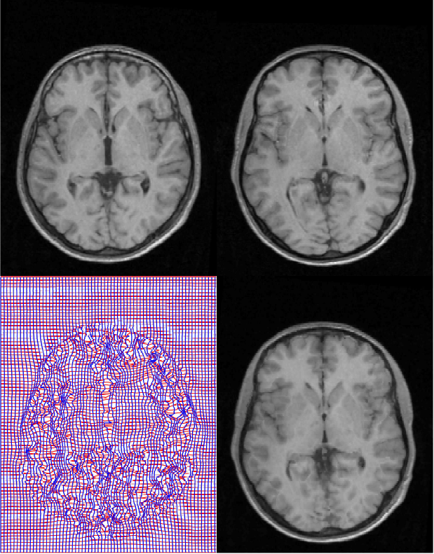
Nonlinear transform
Source
Template
“warping”
Deformation field
Warped image
Notes:
So some software packages use a nonlinear warping algorythm to align brains. There you have to estimate a 3D deformation field and then nonlinearly warp each brain onto a template. They are called non-linear, because different parts of the volume are scaled differently.

Slide 36
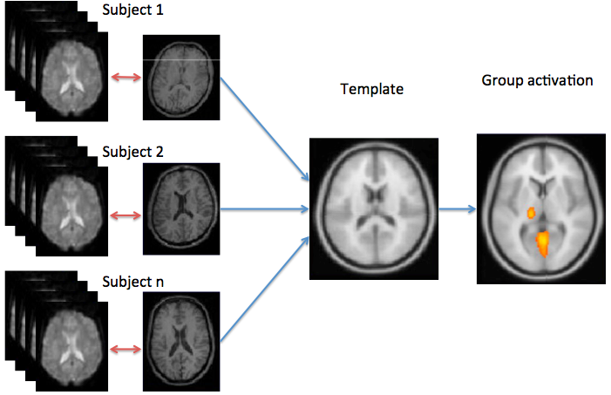
Normalization is usually done using a structural scan
Notes:
The mapping to common space is usally done via an anatomical scan. First, each subject functional and anatomical scans are coregistered with each other, and then each subject’s anatomical scan is mapped into a template. This is done because the anatomical scan has better quality, and hence the estimated transform is more preceise.
After you have done that each area in one subject corresponds to the same area in the other subject and you can perform averaging on them.

Slide 37
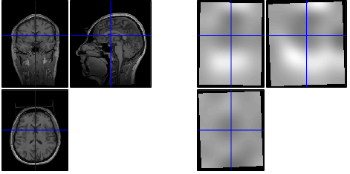
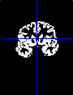
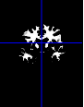
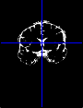
SPM: unified segmentation
Bias correction
Tissue segmentation
Normalization parameters
s14_seg8.mat
J. Ashburner and K.J. Friston, NeuroImage , 2005.

Slide 38
FS-FAST: surface-based registration
individual
fsaverage template
nonlinear spherical registration
Notes:
Fsaverage: 40 subjects;
Align 39 subjects to 1; create an atlas; align 40 subjects to an atlas; re-create atlas; align 40 subject to the atlas; re-create atlas

Slide 39
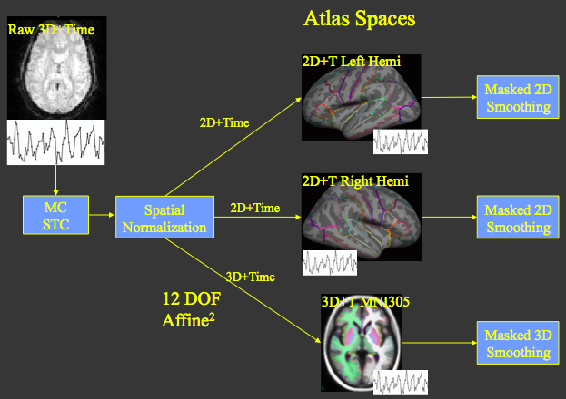
FS-FAST
Slide adapted from Doug Greve
http://surfer.nmr.mgh.harvard.edu/pub/docs/fsfast.april2011.ppt
Notes:
The preprocessing stream then looks as follows:
We got functional dataset out of the scanner. It is a stack of volumes (in 3D), each consisting of single voxels. Each voxel has a time course. So essentially it is a 4D dataset, wehere we treat time as the fourth diemsion.
We first perfomr motion correciton and slice time correction in the volume space, as is done by most other software packages.
But after that, using knolwdge from freesurfer recon, each voxel together with it’s time course is maped to one of the 3 atlas spaces: either the left cortical hemisphere, the right hemisphere or the subcrotical structures like the basal ganglia, amygldala, brainstem, etc. And the atlas spaces in this case are fsaverage.
After this, the spatial smoothing is done either in 2D or in 3D depending on whether it is a surface space or a volume subcortical space, and voxels that do not belong to the space is being basked out.

Slide 40
Typical fMRI preprocessing stream
Slice-time correction
Motion correction
Normalization to atlas space
Coregistration of functional and anatomical data
Smoothing

Slide 41
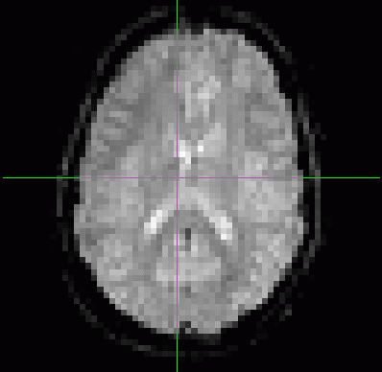
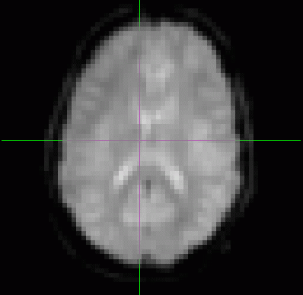
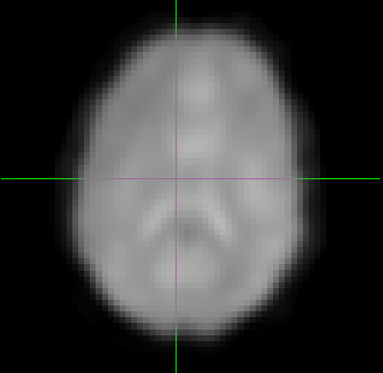
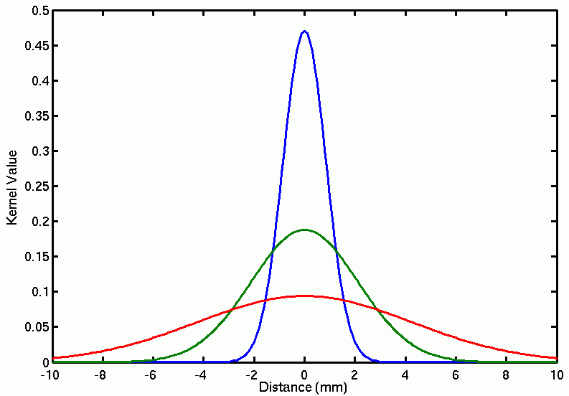
Spatial smoothing
Purpose1: increase the signal and suppress the noise
Purpose2: even better compensate for inter-individual differences
0 FWHM
5 FWHM
10 FWHM
Full-Width/Half-max
Full Max
2mm FWHM
Half Max
5mm FWHM
10mm FWHM
Notes:
Finally, each volume is typically smoothed with a gaussian to increase the signal and supress noise.
The amount of smoothing is usally expressed by the shape of the gaussian, which, in turn, is described by it’s full withd at half maximum. Here are the examples of the original volume, the smoothed volume at 5 fwhm and 10 fwhm. You can see that the signal increase happends at the expense of the spatialresolution

Slide 42
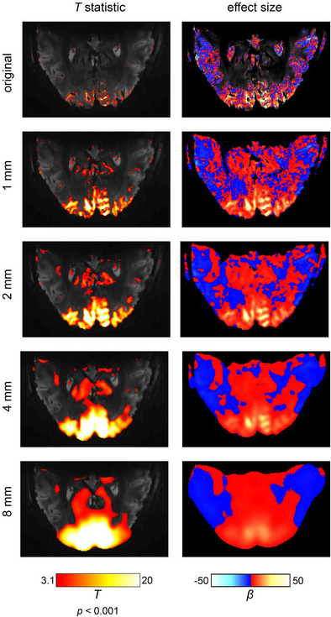
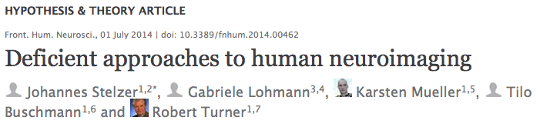
Notes:
Volume smoothing has been heavily critisized by some influential people in the field. It has even been called “deficient approaches to human neuroimaging”.
Because it does not only degrade the resoulution, but also decreases the effect size.
But it is still being done in many cases – it all depends on the questions you are asking

Slide 43
Spatial smoothing
Purpose1: increase the signal and suppress the noise
Purpose2: even better compensate for inter-individual differences
0 FWHM
5 FWHM
10 FWHM
Full-Width/Half-max
Full Max
2mm FWHM
Half Max
5mm FWHM
10mm FWHM
Notes:
Finally, each volume is typically smoothed with a gaussian to increase the signal and supress noise.
The amount of smoothing is usally expressed by the shape of the gaussian, which, in turn, is described by it’s full withd at half maximum. Here are the examples of the original volume, the smoothed volume at 5 fwhm and 10 fwhm. You can see that the signal increase happends at the expense of the spatialresolution

Slide 44
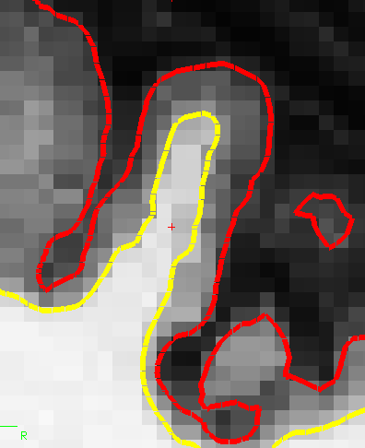
Volume- vs. Surface-based smoothing
5 mm apart in 3D
25 mm apart on surface
Averaging with other tissue types (WM, CSF)
Averaging with other functional areas
14 mm FWHM
Notes:
One important feature is that fsfast allows surface-based processing, and therefore overcomes some of the dificulties caused by smoothing.
Here is an example of how it works. Here is a piece of freesrurfer reocnstructed cortical surface with yellow a white matter surface and red the the gray matter surface. The two points, on opposite banks of the sulcus, are only 5 mm apart in the volume,
howerver, they are very far from each other on the surface. So these two points can be two completely different functiona areas.
However, if you smooth on the volume, as shown here, you will mix them thogether.
FsFast uses the information from the freesurfer’s surface reconstruciton and smoothes the data along the cortical surface. This allows to take advanta of smoothing procedure without mixing these two areas together.

Slide 45
FS-FAST

Slide 46
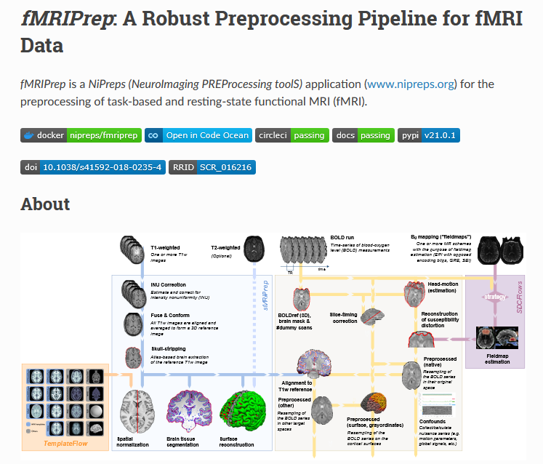
In the 21st century…
https://fmriprep.org/en/stable/

Slide 47
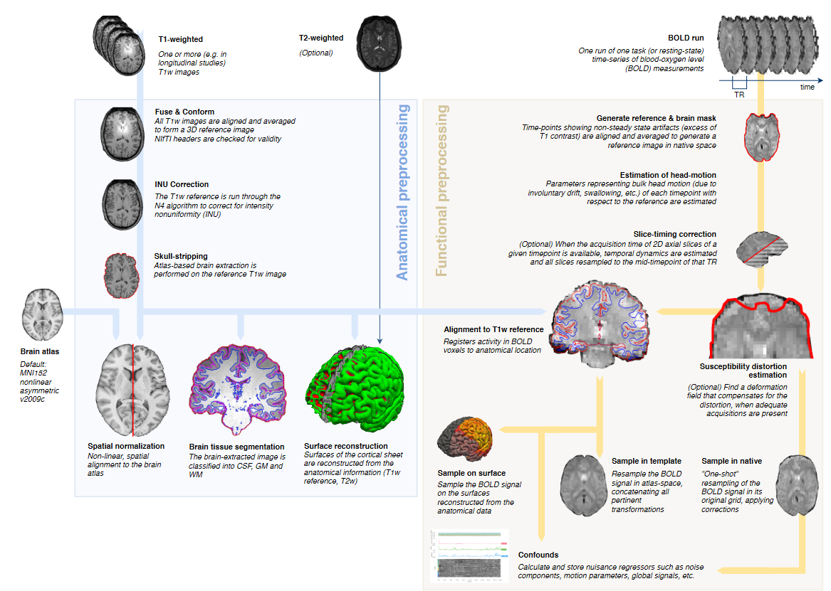
https://fmriprep.org/en/stable/

Slide 48

fMRIprep
Pros
Cons
Useful for many subjects, whole-brain data, standard acquisitions
Collection of best practices from all software
HPC compatibility
Useful for “users” when knowledgeable people do it for them
Automatic quality control
Increases reproducibility (?)
Not useful for custom acquisitions
May not worth it with few subjects
Requires a Linux environment and corresponding knowledge
Need integration with the software you will use for your analysis
Hard to explain what you did in a paper

Slide 49
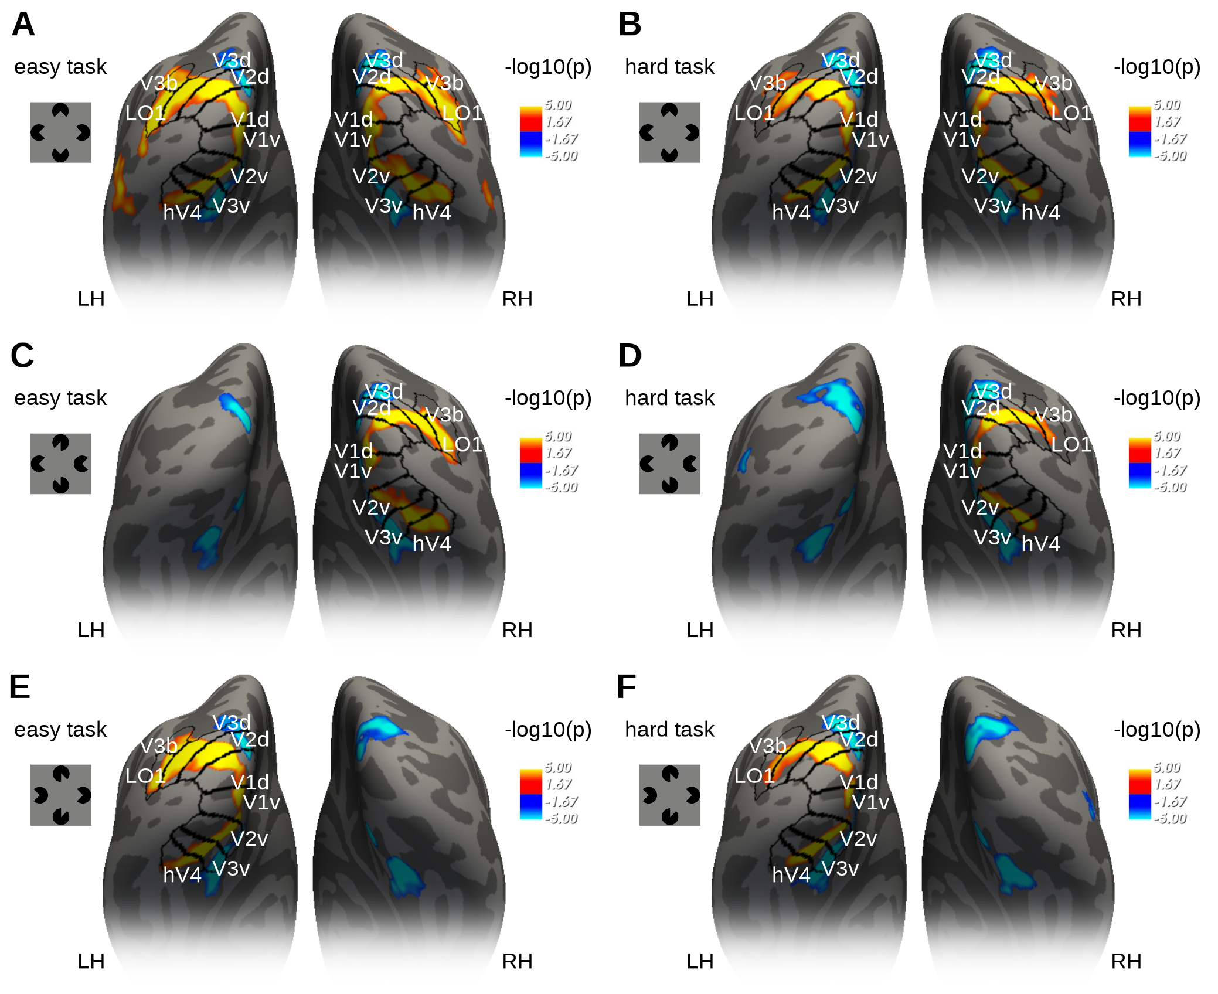

Example I
Work by Ana Arsenovic

Slide 50






Example II
7T - 0.75mm
Work by Adam Coates

Slide 51
Break or the End

Slide 52
fMRI analysis
First-level analysis
(= single-subject = time-series analysis)
Group analysis
Multiple comparison correction

Slide 53
Single-subject (first-level) analysis
Univariate/voxel-wise analysis
Question: Which areas are activated by the flickering checkerboard?
Notes:
Remember that an image is 4d and consists of little 3d cubes called voxels, with the 4th diemtion being time.
A calssical analysis is done over tiem for every voxel in the brain independelty

Slide 54
Checkerboard experiment
Notes:
Let’s recall our checkerboard experiment where particients viewed either a checkerboard or a gray screen. Let’s also creata a function, called the stimulsu function, which is one where the checkerboard was on, and zero where the checkerboard was off

Slide 55
Checkerboard experiment
Notes:
Let’s now look at the time course of a voxel in the visual coretx. You see that it is noisy and delayed, but it kind of follows the stimulus.

Slide 56
General Linear Model (GLM)
Build a prediction about the signal
Fit prediction to actual data
If it fits nicely – there is activation!
Notes:
However, there is a better way called the General linear model (shortly called glm)
It boils down to making a prediction about the signal time course and comparing this prediction with the measured signal

Slide 57
Building regressors
convolution
Notes:
How can we build a prediction about the signal?
Well, we know the timing of the stimulus on the screen – called the stimulus function, and we know a tiypical shape of the hemodynamic response.
The signal prediction, called a regressor, is creased by the convolution operation between the stimulus function and the HRF.
The result of this convolution is will look like this:
Since we know aaproximately what a signal should look like – It is our hemodynamic response function. By convolution of the stimulus function with hrf we can generate a signal predictor, which is called a regressor.
Then we fit the regressor to the measured signal. If it fits nicely there is an activation. How we decide if it fits nicely?

Slide 58
Building regressors
convolution
Notes:
Now we fit our prediction to the data (shown in read). If it fits nicely there is an activation. How we decide if it fits nicely?

Slide 59
General Linear Model
Y(t) = β * X(t) + c + e(t)
Measured data
Modeled data (regressors)
Constant offset
Error (e.g. noise, confounds)
Notes:
How do we know that it fits nicely?
Using a least square estimation of a linear regression, called the genral linear model (GLM)
The assumption behind glm is that you signal Y consists of a sum of the folloing terms:
Modelled response (regressor)
Constant offset (which is not so important)
And some residual error (scanner noise, confounds, etc)
Where beta term, aslo called the beta weight, reflects how well your model fits the data.

Slide 60

General linear model fit
Y = Xβ + e
β = (X^{T}X)⁻¹X^{T}y

Slide 61



Statistical inference (t-test) in GLM
Voxel-wise t-statistic
3D t-statistic map
Final result
t = β/SE(β)
72,221 voxels
Thresholding:
deal with the multiple comparison problem!
Notes:
How do we get from beta estimates to making statistical inference? Rejecting the null hypothesis?
The good thing is that beta estimated devided by its standard eroor is a t-statistic with a t-distribution. So to know wheter an activation in one voxel is significant is relatively straifhtforward.
If we had just one voxel, we would have computed the t-statistic, and then depending on the degrees of freedom determined if it exceeds the critical value.
However, we are doing the same statistical test for MANY voxels. SO the probability that we find a significant voxel simply by chance increases. This is the multiple comparison problem that is encountered anywhere in statistics. In fMRI it is particularly prominent, because the number if singe tests is enormous.
There are several ways and philosophies for dealign with it, I won’t go into details right now. The important thing is that any voxel wise analysis MUST deal with this problem in some way.

Slide 62


Multiple comparisons correction

Slide 63
What about two conditions?
Condition A
Condition B

Slide 64
General Linear Model
Y(t) = β1 * X1(t) + β2 * X2(t) + c + e(t)
Measured data
Modeled data (regressor 1)
Modeled data (regressor 2)
Error (e.g. noise, confounds)
Notes:
How do we know that it fits nicely?
Using a least square estimation of a linear regression, called the genral linear model (GLM)
The assumption behind glm is that you signal Y consists of a sum of the folloing terms:
Modelled response (regressor)
Constant offset (which is not so important)
And some residual error (scanner noise, confounds, etc)
Where beta term, aslo called the beta weight, reflects how well your model fits the data.

Slide 65
Statistical inference (t-test) in GLM
Voxel-wise t-statistic
3D t-statistic map
Final result
t = (β1 – β2) / SE(β1;β2)
72,221 voxels
Thresholding:
deal with multiple comparison problem!
Notes:
How do we get from beta estimates to making statistical inference? Rejecting the null hypothesis?
The good thing is that beta estimated devided by its standard eroor is a t-statistic with a t-distribution. So to know wheter an activation in one voxel is significant is relatively straifhtforward.
If we had just one voxel, we would have computed the t-statistic, and then depending on the degrees of freedom determined if it exceeds the critical value.
However, we are doing the same statistical test for MANY voxels. SO the probability that we find a significant voxel simply by chance increases. This is the multiple comparison problem that is encountered anywhere in statistics. In fMRI it is particularly prominent, because the number if singe tests is enormous.
There are several ways and philosophies for dealign with it, I won’t go into details right now. The important thing is that any voxel wise analysis MUST deal with this problem in some way.

Slide 66

What about X conditions? Design Matrix
Conditions of interest
regressors
Nuissance regressors
time
Y = Xβ + e
Notes:
In principle, you can have as many regressors as you like; some of them will be you experimental conditions; some of them will be confound regressors, the so-called “nuisance regressors”.
They all comprize a matrix called the design matrix.
Here I have taken the most complex design matrix I could find in with google, I think it contains around 70 regressors.
They are located along the colums. Along the rows we have a time dimenstion. After the glm fit each of these regressors will have a beta estimate.
This offers a lot of flexibility about what you can do with beta estimates.

Slide 67

Contrast: linear combination of betas
Contrast vector: describes how beta-estimates are combined (“weighted”)
Contrast image: a 3D volume containing the result of beta-combinations
Y(t) = β1*X1(t) + β2* X2(t) + c + e(t)
[ 1 -1 ]
β1-β2
Notes:
An inportant term in the general linear model analysis is contrast.
Contrast is just the linear combination of bete estimates that you are interested in.
In our example we have compared tow beta estimates, and the contrast was 1 -1 0
but you can test the statistical significance of more complex combinations of beta estimates.
The way in which you combine the beta estimates is described by a verctor called contrast vector.
After you have combined the beta estimates according to the contrast vector, you get a contrast image – which is a 3D volume in which every voxel contains a result of beta combinations.

Slide 68
Group analysis (second-level analysis)
Subject 1 contrast image
Voxel-wise one-sample t-test
Subject 2 contrast image
3D t-statistic map
Final result
Subject n contrast image
Is our combination of betas different from zero?
Thresholding:
deal with multiple comparison problem!
Notes:
When we have the contrast images we are interested in, i.e. gocnigionon A vs condition B, we are ready for the gorup analysis.
Typically, you combute one contrast image per subject which corresponds to your hypothesis. Then you use the contrast images to do a one – sample t-test. It tests whether your contrast image is significantly different form zero.
After you’ve computed a one-sample t-test for every voxel, the procedue is the same as for the individual analysis; you need to threshold the image accounting for the multiple comparison problem.

Slide 69
GLM advantages
Complex experimental designs
“Regress out” uninteresting effects/confounds
Estimate HRF shape
?
Notes:
A GLM has approach has several advantages over the simple binning of data.

Slide 70
Different software, different philosophies
Since 1994
http://www.fil.ion.ucl.ac.uk/spm/
https://github.com/wanderine/BROCCOLI/
Since 1994
Doug Greve
http://afni.nimh.nih.gov/afni/
Since 2000
http://fsl.fmrib.ox.ac.uk/fsl/fslwiki/
https://surfer.nmr.mgh.harvard.edu/fswiki/FsFast
Notes:
At the end I would like to mention the major software packages, which are availabe. All of them have implemented the preprocessing steps that we have discussed as well as the GLM analysis.
SPM – statistical parameteric mapping. It is a free matlab based toolbox. However, it depends on the matlab licence.
FSL from oxford – a set of linux tools, also free
And last but not least, since we are here at the martinos center, I guess it is convinient to use the centeres freesurfer and fsfast routine. As you may know, freesurfer is a structural popline for cortial surface reconstruction and lot’s of other surfaces. FsFast, developped by doug greeve, is a funcitonal module, which is very well integrated with freesurfer, and has several advantages over these two.

Slide 71
SPM vs. FS-FAST
Doug Greve
Notes:
http://buddyboy600.deviantart.com/art/London-Big-Ben-vs-Boston-Custom-House-525853803
Today we will focus on the two software packages, SPM on one hand, and fsFAST on the other.
One of the main reasons for this choice is because I am most familiar with these two ones, and can’t tell you much about the other ones.
Another reason is bacuase SPM in particular, as I mentioned, is one of the oldest software packages and one of the most popular ones, and many of the general principles of fMRI analysis were invented and first implemented in SPM. We will compare it with fsfast and see what are the advantages and disadvatages of each.

Slide 72



SPM vs. FS-FAST
SPM: 1 volume space
FS-FAST: 2 surface spaces and
1 subcortical volume space
3D “blobs”

Slide 73



SPM: Family-Wise Error (FWE)
SPM{t}
“soft” Bonferroni correction
Based on Gaussian Random Field Theory
Assumes spatial Gaussian distribution voxel values
Threshold controls the probability (e.g. p<0.05 ) of false positive blobs (“resels”) instead of false positive voxels
For some more maths and explanations see:
http://imaging.mrc-cbu.cam.ac.uk/imaging/PrinciplesRandomFields#The_multiple_comparison_problem
Notes:
Determine n resels (related to smoothness, Smoothness is determined from the covariance of the residulas (remaining signal that is not modelled in your GLM))
Determine Expected Euler characteristic of an image when thresholded at different levels (EC – roughly number of blobs after thresholding, complicated formula, but depends on the number of resels)
Use Euler characteristic distribution to determine the threshold for required fals-positive probability (e.g. 0.05)
SPM likes to use a method called family-wise error correction;
In principle, it can be viewed as kind of soft bonferronly correciton, but with the way more complicated math gehind it called the gaussian random field theory.
The main idea behind this method is that a value in each voxel is not independent from it’s neigbours. And you can see that it is true, especially when the data has been smoothed, or t-map values vary smoothly across the brain volume.
So instead of figureing out the threshold such that the number of false poistive voxels is kept at a certain leve, e.g. 0.05, it tries to figure out how many false positive blobs you will get.

Slide 74




FS-FAST: cluster-wise correction
True activations tend to cluster
Threshold a map at some p-value
Generate random noise, analyze it like real data, get maximal cluster size
Repeat many times and get a distribution of maximal cluster sizes observed in noise
Compare each of your real clusters to the distribution
P(cluster) = probability of seeing a maximum cluster of that size or larger in noise
Unthresholded
p<.0001
mri_glmfit-sim
https://surfer.nmr.mgh.harvard.edu/fswiki/FsTutorial/GroupAnalysis#ClusterwiseCorrectionforMultipleComparisons
Notes:
FDR: proportion of false positives rather than probability of AT LEAST ONE false positive

Slide 75


Functional connectivity: SPM
Psycho-physiological interactions (PPI)
Dynamic causal modeling (DCM)
connectivity in task A vs. task B
Directed interaction between areas

Slide 76

Functional Connectivity: SPM

Slide 77

Functional connectivity: FS-FAST
seed-based FC at rest
fcseed-config
fcseed-sess

Slide 78
Useful links
SPM
http://www.fil.ion.ucl.ac.uk/spm/doc/
http://imaging.mrc-cbu.cam.ac.uk/imaging/SpmMiniCourse
FS-FAST
https://surfer.nmr.mgh.harvard.edu/fswiki/FsFastTutorialV5.1
https://surfer.nmr.mgh.harvard.edu/pub/docs/fsfast.april2011.ppt (Doug’s FS-FAST lecture slides)
https://www.youtube.com/watch?v=Q1RoThGmuxk

Slide 79
Thank you for your attention!

